Slide 2
Real-Time ML at Planet-Scale with DocumentDB, HDInsight, and Spark
Andrew Liu
PM, Azure DocumentDB

Slide 3
Topics Covered
Brief overview of Azure DocumentDB
Brief overview of Azure HDInsight
Lab: Apache Spark + Azure DocumentDB + HDInsight

Slide 4
Azure DocumentDB

Slide 5

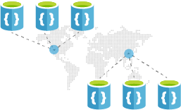
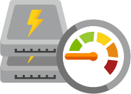
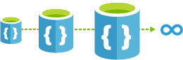

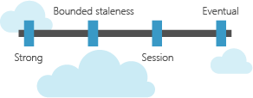

Azure DocumentDB
Fast and scalable, globally-distributed NoSQL database service for apps with global reach
Globally Distributed
Guaranteed low latency
Infinitely scalable
Schema-free SQL and JavaScript queries
Tunable consistency models
Fully managed with enterprise-grade SLAs

Slide 6
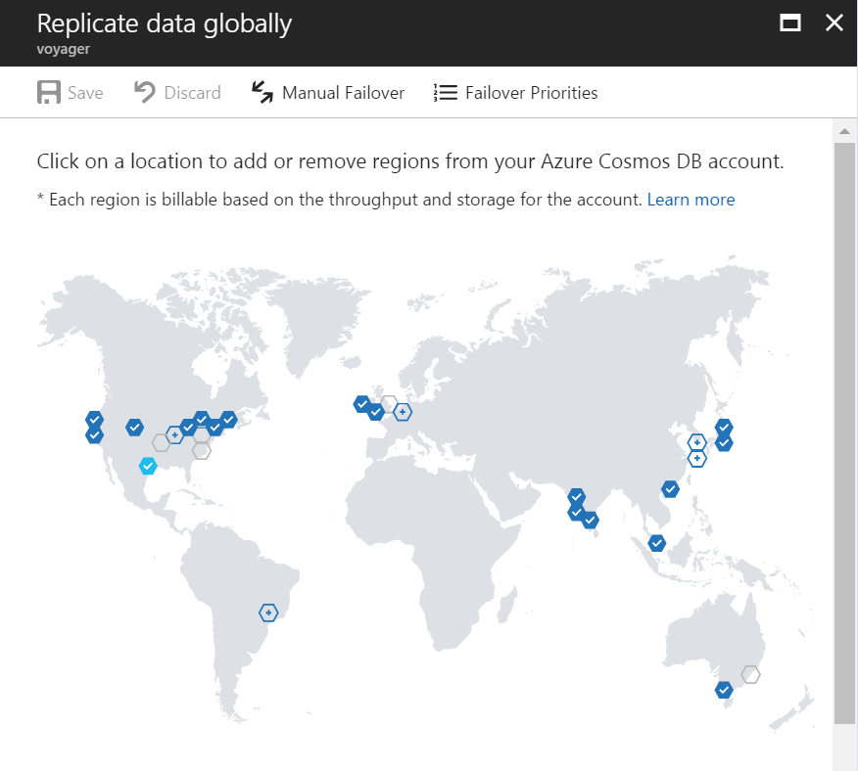
Global Distribution
Worldwide presence
Automatic multi-region replication
Multi-homing APIs
Manual and automatic failovers

Slide 7
Elastically Scale-out
Partition management is automatically taken care of for you
Independently scale storage and throughput
Scale storage from Gigabytes to Petabytes
Scale throughput from 100's to 100,000,000's of requests/second
Dial up/down throughput and provision only what is needed
12000000
10000000
8000000
6000000
4000000
2000000
Black Friday
Provisioned request / sec
Nov 2016
Dec 2016
Time
Hourly throughput (request/sec)

Slide 8
Guaranteed low latency
Reads (1KB)
Indexed Writes (1KB)
Globally distributed with requests served from local region
Write optimized, latch-free database
Automatic Indexing
P50
<2ms
<6ms
P99
<10ms
<15ms

Slide 9
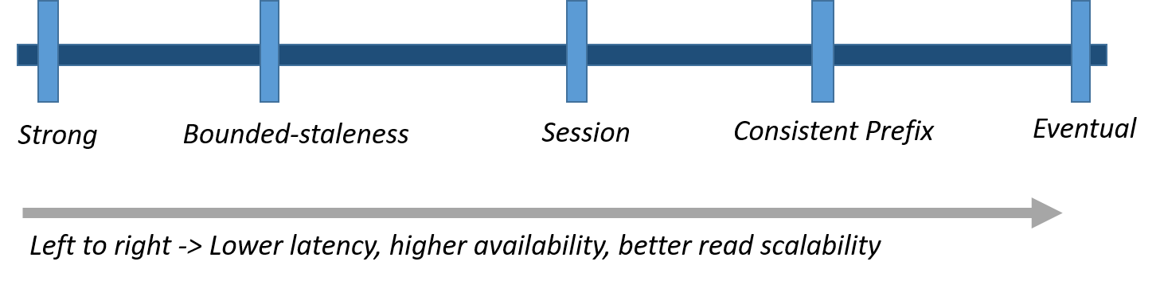
Five Consistency Models
Helps navigate Brewer's CAP theorem
Intuitive Programming
Tunable well-defined consistency levels
Override on per-request basis
Clear PACELC tradeoffs
Partition – Availability vs Consistency
Else – Latency vs Consistency

Slide 10
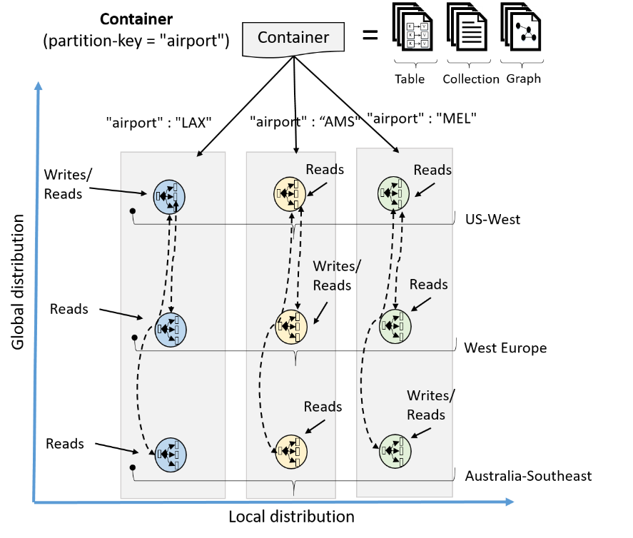
Comprehensive SLAs
99.99% availability
Durable quorum committed writes
Latency, consistency, and throughput also covered by financially backed SLAs
Made possible with highly-redundant architecture

Slide 11
Azure HDInsight

Slide 12






Managed Open Source Analytics for the cloud with a 99.9% SLA.
100% Open Source Hortonworks data platform
Clusters up and running in minutes
63% lower TCO than deploy your own Hadoop on-premises
Separation of compute and store allows you to scale clusters to exponentially reduce costs

Slide 13
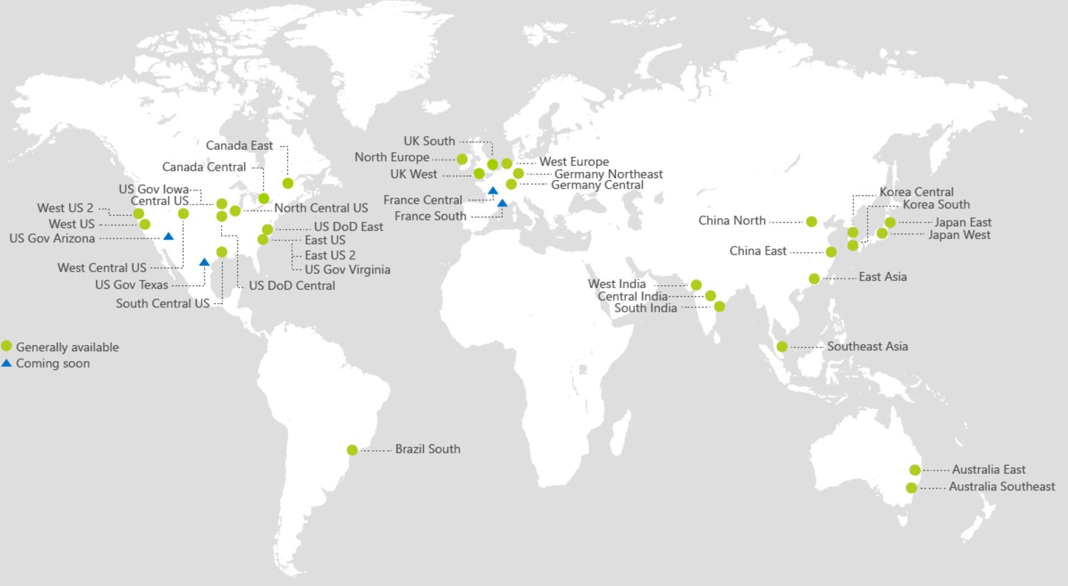
Multi Region Availability
Available in >25 regions world-wide
Launched most recently in US West 2, and UK regions
Available in China, Europe and US Gov clouds

Slide 14





Security and Compliance to enable OSS for Enterprises
Authentication
Azure Active Directory
Kerberos authentication
Perimeter Level Security
Virtual Networks
Network Security Groups (firewalls)
Authorization
Apache Ranger
RBAC for Admin
POSIX ACLs for Data Plane
Data Security
Server-Side encryption at rest
HTTPS/TLS In-transit

Slide 15





Developer ecosystem
Plugins for HDI available for most popular IDEs for agile development and debugging
Rich support for powerful notebooks used by data scientists
Develop in C#, deploy on Linux in Java via HDI developed SCP.Net technology

Slide 16
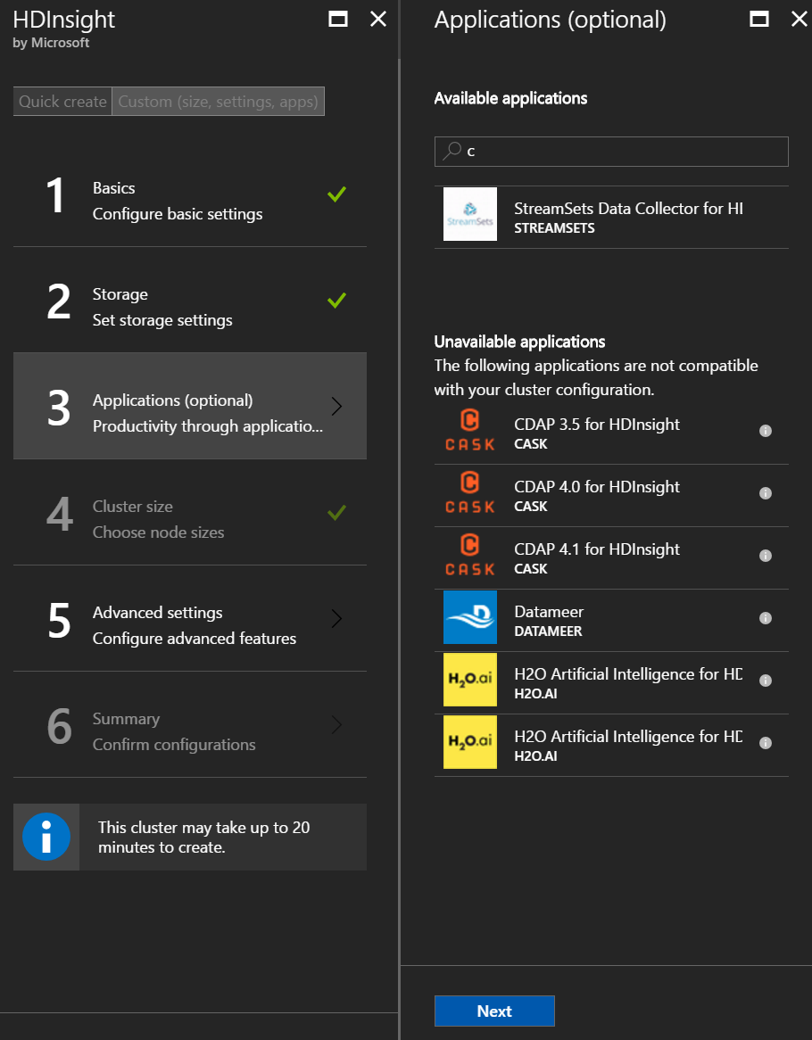




Easy ISV integration as you deploy the cluster

Slide 17











Reference Big Data Analytics Pipeline
Data Sources
Ingest
Prepare
(normalize, clean, etc.)
Analyze
(stat analysis, ML, etc.)
Publish
(for programmatic consumption, BI/visualization)
Consume
(Alerts, Operational Stats, Insights)
REALTIME ANALYTICS
Business apps
Realtime Machine Learning
(Anomaly Detection)
PowerBI dashboard
Custom apps
Azure Stream Analytics
(Shared with field Ops, customers, MIS, and Engineers)
DocumentDB
Sensors + devices
INTERACTIVE ANALYTICS
HDI Custom ETL
Aggregate /Partition
Machine Learning (Spark + Azure ML)
(Failure and RCA
Predictions)
HDI + ISVs
OLAP for Data Warehousing
Operational logs
Big Data Storage
Azure Data Lake Store
DocumentDB
Azure Blob Storage
Local DB Logs
BATCH ANALYTICS
Big Data Storage
HDI + ISVs
OLAP for Data Warehousing
Legacy Data
Hive, Spark processing
(Big Data Processing)

Slide 18
Data at Massive Scale: Azure DocumentDB + HDInsight

Slide 19







Real-Time Analytics and Internet of Things
Aggregated + Archived Events (Cold)
pre-aggregates
Apache Storm on
Azure HDInsight
Azure DocumentDB (Hot)
(telemetry and device state)
Azure IoT Hub
high-fidelity events
latest state
PowerBI
Azure Logic Apps
Azure Web Jobs
(Change feed processor)

Slide 20

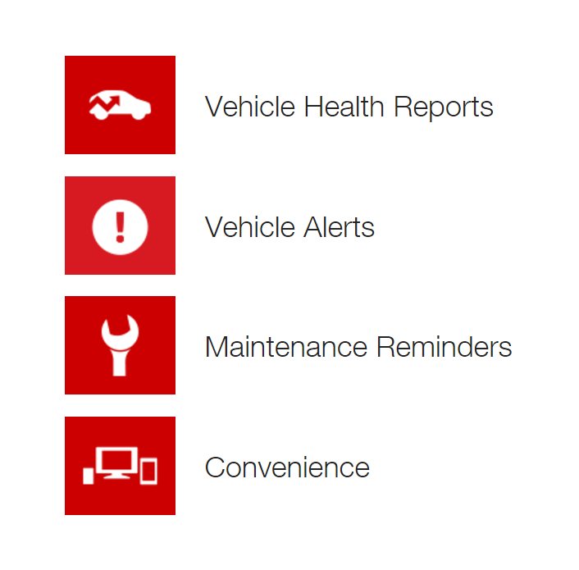
Toyota drives connected car push forward with:
Azure DocumentDB and Apache Storm on HDInsight
Business need
Need to ingest massive volumes of diagnostic data from vehicles and take real-time actions as part of connected car platform
Management and operations of database infrastructure to handle exponential growth of data
Key benefits
DocumentDB can scale elastically without operational overhead of MongoDB
Perform fast queries over events to deliver safety, diagnostic, and remote services to Toyota customers

Slide 21








Data Science Scenarios
weather
global safety
alerts
Device
Notifications
Flight
information
Azure DocumentDB
Web / REST API

Slide 22
Scale-out Computation
Spark SQL
Spark Streaming
GraphX (graph)
MLlib (machine learning)
Apache Spark on HDInsight
Scale-out Database
Spark Connector using DocumentDB API
Azure DocumentDB

Slide 23
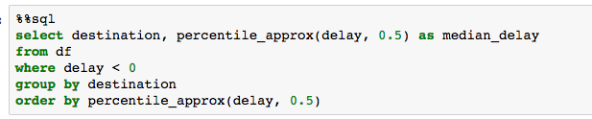
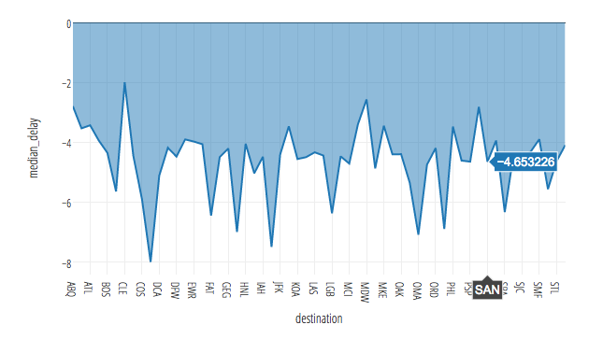
Spark connector for Azure DocumentDB with HDInsight Distributed Aggregations and Analytics

Slide 24
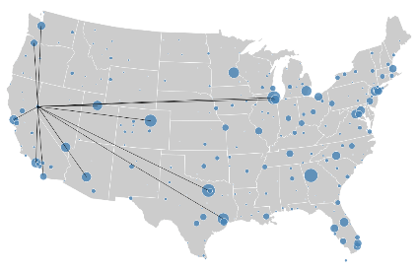
Spark connector for Azure DocumentDB with HDInsight Pushdown Predicate Filtering
Data Science Scenarios
{city:SEA}
locations
headquarter
exports
0
1
{city:SEA, dst: POR, ...},
{city:SEA, dst: JFK, ...},
{city:SEA, dst: SFO, ...},
{city:SEA, dst: YVR, ...},
{city:SEA, dst: YUL, ...},
...
Belgium
0
1
country
city
country
city
city
city
Germany
Seattle
France
Paris
Moscow
Athens

Slide 25
Spark connector for Azure DocumentDB with HDInsight Updateable Columns
Data Science Scenarios
{delay:-30}
{
tripid: “100100”,
delay: -5,
time: “01:00:01”
}
{
tripid: “100100”,
delay: -30,
time: “01:00:01”
}
{delay:-30}
Device
Notifications
Flight
information
Web / REST API
{delay:-30}

Slide 26
Lab: Spark connector for Azure DocumentDB + HDInsight

Slide 27
Try this out today!
Get started with Azure DocumentDB
Get started with Azure HDInsight
Lab: Setup Spark on DocumentDB + HDInsight
Lab: Spark on DocumentDB Notebook
Have Feedback/Questions? Reach out to us --
AskOSSNoSQL@microsoft.com

